Slide 1
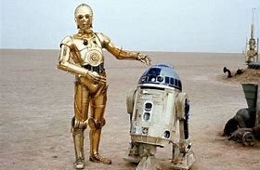
Ratio Applications
Name those characters?
EQ: How do I divide a quantity in a given ratio?

Slide 2

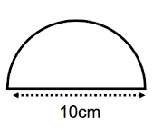
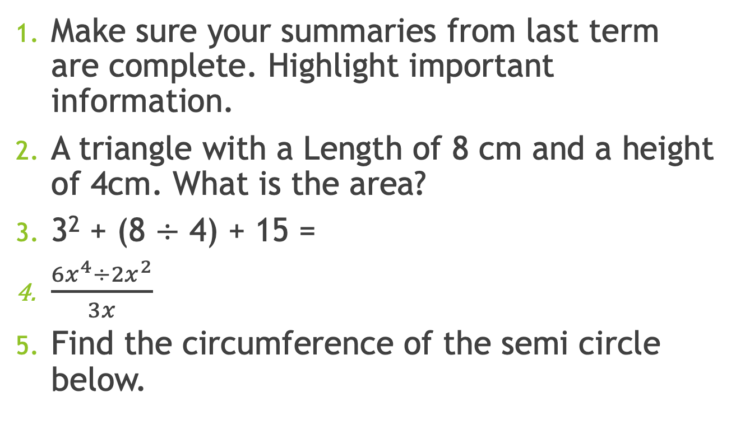
Daily 5
Topic: Ratio Application EQ: How do I divide a quantity in a given ratio?
Make sure your summaries from last term are complete. Highlight important information.
A triangle with a Length of 8 cm and a height of 4cm. What is the area?
3² + (8 $÷$ 4) + 15 =
$\frac{{6x}^{4}÷{2x}^{2}}{3x}$
Find the circumference of the semi circle below.

Slide 3
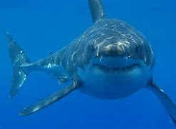
Trivia Question
Do sharks have tongues?
Answer on next slide

Slide 4
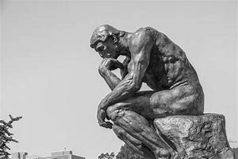
Revision on equivalent ratio’s
Sharks have tongues..
Find three equivalent ratio’s for each of the following: The first is done for you.
3 : 5 – 9 : 15, 21 : 35, 30 : 50.
1 : 2 -
8 : 7 -
4 : 12 -
14 : 49 -

Slide 5
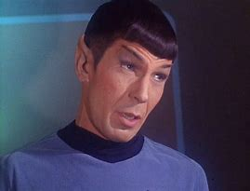
Simplify the following ratio’s.
250kg : 5 tonnes = turn tonnes to kgs 250 : 5000 = 1 : 20
16 : 8
40 : 8
2000ml : 15L
96 : 156
240 seconds : 2 mins
Who is this? And what does he say?

Slide 6
Ratio Applications EQ: How do I divide a quantity in a given ratio?
Ratios are used in many different places. Some examples include:
Mixing cement
Baking
Medicine
Think of a ratio in terms of parts. A ratio of 2 : 3 has a total of 5 parts.
Use the following procedure:
Find the total number of parts in the ratio.
Find the value of one part.
Find the valve of the number of parts.
This is know as the unitary method.

Slide 7
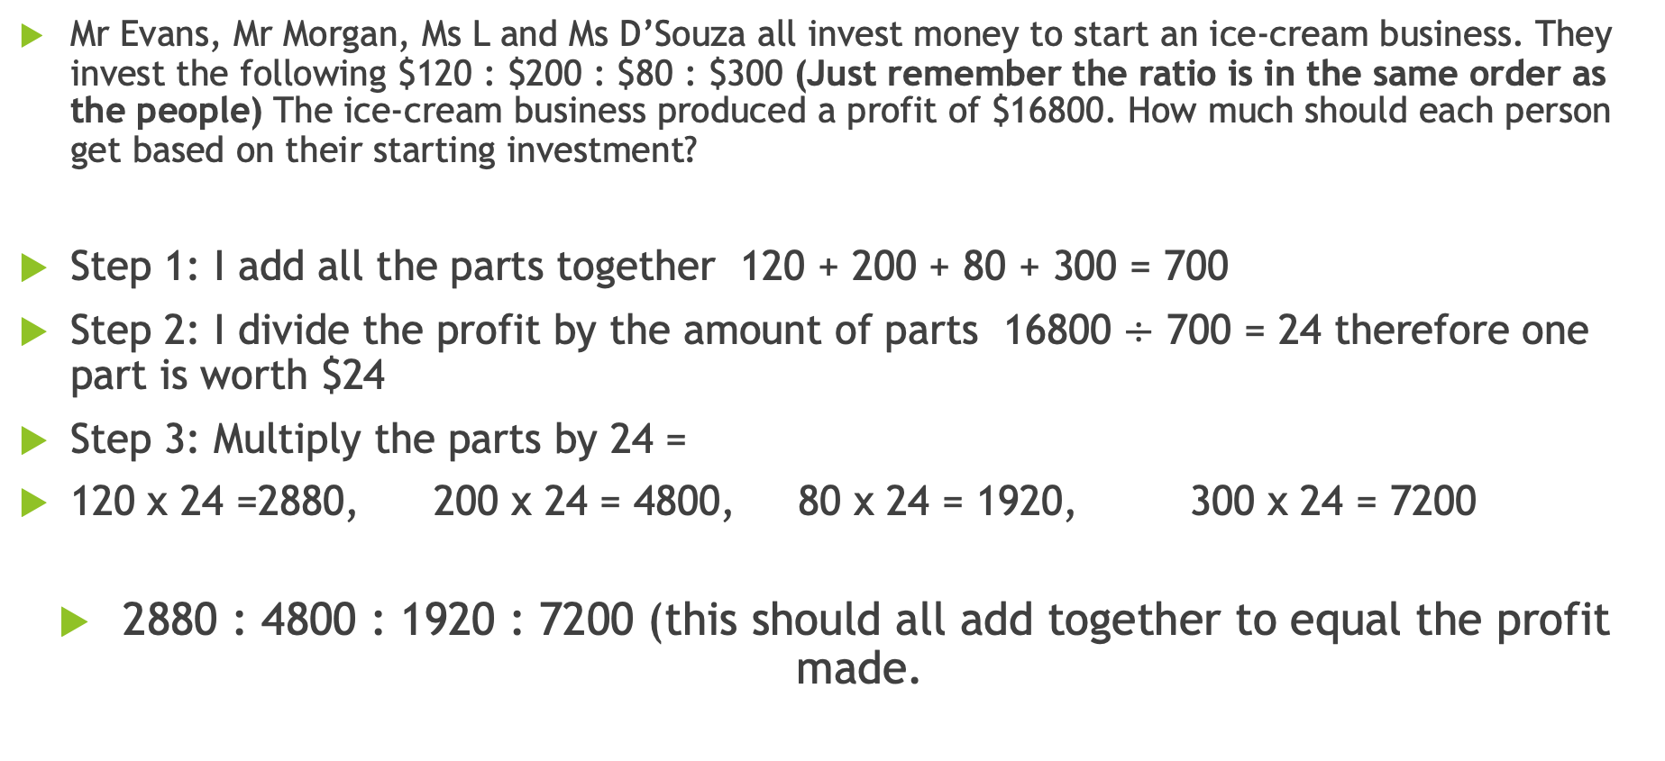
The ice-cream problem
Mr Evans, Mr Morgan, Ms L and Ms D’Souza all invest money to start an ice-cream business. They invest the following $120 : $200 : $80 : $300 (Just remember the ratio is in the same order as the people) The ice-cream business produced a profit of $16800. How much should each person get based on their starting investment?
Step 1: I add all the parts together 120 + 200 + 80 + 300 = 700
Step 2: I divide the profit by the amount of parts 16800 $÷$ 700 = 24 therefore one part is worth $24
Step 3: Multiply the parts by 24 =
120 x 24 =2880, 200 x 24 = 4800, 80 x 24 = 1920, 300 x 24 = 7200
2880 : 4800 : 1920 : 7200 (this should all add together to equal the profit made.

Slide 8
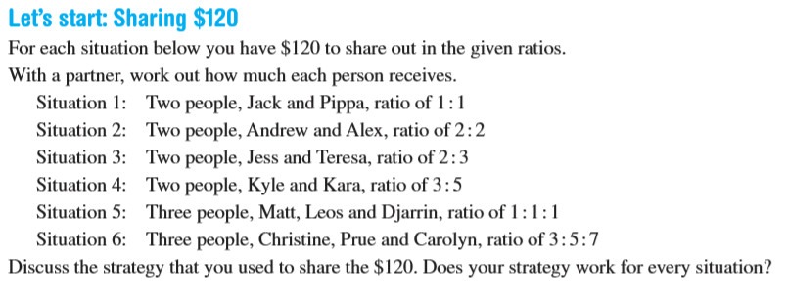
The Sharing problem

Slide 9
The lottery problem
Mr Wilson, Mrs Keen and Mr Craig buy a lottery ticket. They put in different amounts of money to purchase the ticket as seen in the ratio $5 : $8 : $2. They won $7500000. How much do they get each?

Slide 10
The Feed me problem:
Julie has three different size dogs called Zeus, Thor and Marty. Each dog requires a different amount of biscuits per week (each part represents a cup of food). Each week her dogs require the following cups 14 : 21 : 35. Julie spends 55 dollars on food per week. How much money does it take to feed each dog?

Slide 11
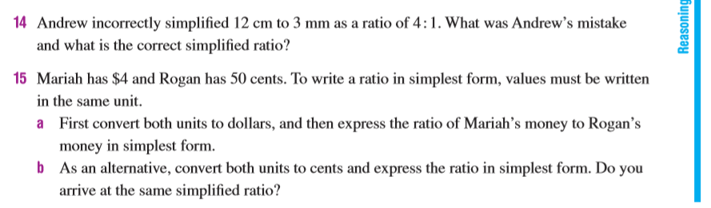
Discussion Questions:

Slide 12
A short quick write
Please take 2 minutes and write down what you have learnt about ratio’s.

Slide 13

Have yourself a wonderful day and don’t forget….

